Slide 1


Data Governance @ SneakerPark
Prepared by: Maleina Bidek
Submitted on: November 5, 2023

Slide 2
Background
SneakerPark is an online shoe reseller that allows people to buy and sell used and new shoes. Buyers can bid for shoes or buy them outright, and sellers can set a price or sell to the highest bidder.
Each buyer and seller must have an active account in order to sell, bid, or purchase sneakers using SneakerPark’s website.
SneakerPark authenticates the shoes before shipping them to the buyer, so before listing an item, the seller must ship it to SneakerPark’s warehouse. Upon receipt, SneakerPark assigns an item number to each pair of sneakers and notifies the seller that they are now free to list their item. If the item is not listed within 45 days, SneakerPark returns it to the seller and sends an invoice to the seller for the shipping cost.
If the item is found to be inauthentic or in an unacceptable condition, it is also returned back to the seller in a similar fashion.
When the item sells, the buyer’s account is credited with the purchase price minus the SneakerPark service fee and shipping fees to deliver the item to the buyer.
Currently, SneakerPark only supports sales within the United States.

Slide 3
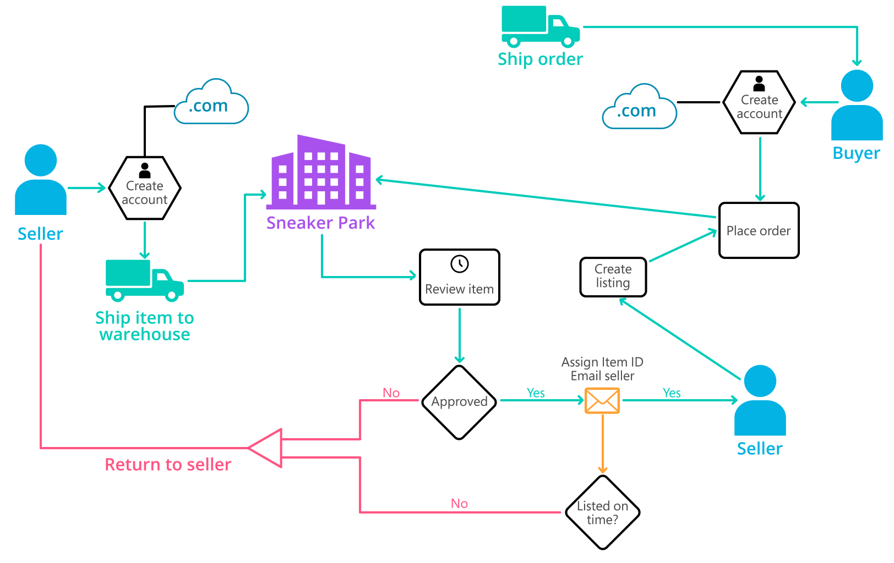
Background (cont’d)
Below you can see a diagram that will hopefully help you visualize some of SneakerPark's business processes. Keep in mind that it does not capture ALL processes and every nuance, but simply serves as another artifact to use in your project.

Slide 4
Step 1
Enterprise Data Catalog Part 1: Enterprise Data Model

Slide 5
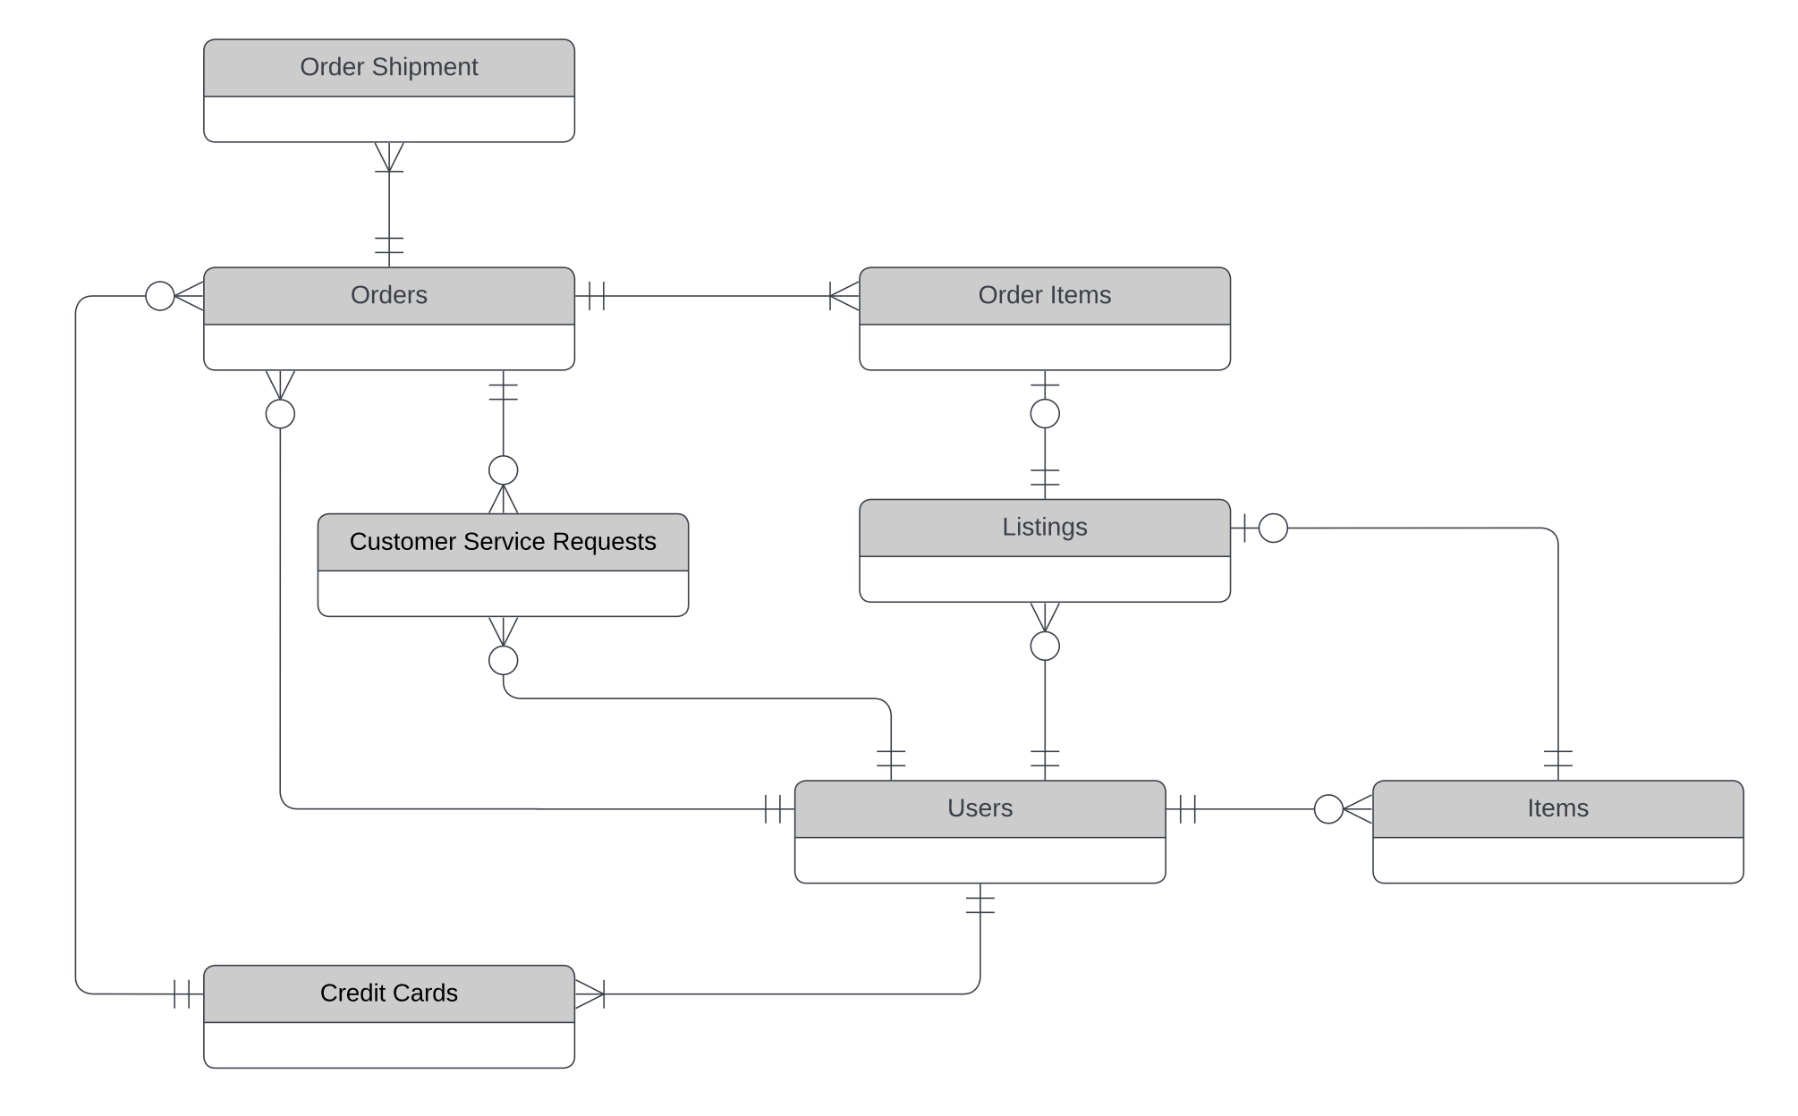
SneakerPark Conceptual Enterprise Data Model:

Slide 6
Step 2
Enterprise Data Catalog Part 2: Metadata

Slide 7
The first version of the Metadata Catalog, which includes the metadata from all systemsneakerpark_data_dict_and_quality_mbidek.xlsx s, is in the spreadsheet entitled in the "Data Dictionary" and the “Enterprise Data Catalog” tabs.

Slide 8
Step 3
Data Quality
Part 1: Profiling and Cleansing

Slide 9
We have identified 3 data quality issues and 1 potential data quality issue in the "Data Quality Issues" tab of the spreadsheet entitled sneakerpark_data_dict_and_quality_mbidek.xlsx.

Slide 10
Step 4
Data Quality
Part 2: Monitoring

Slide 11
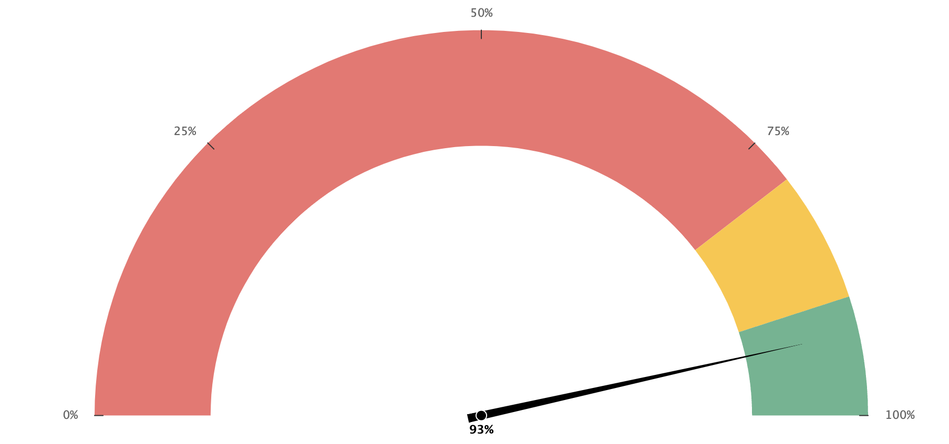
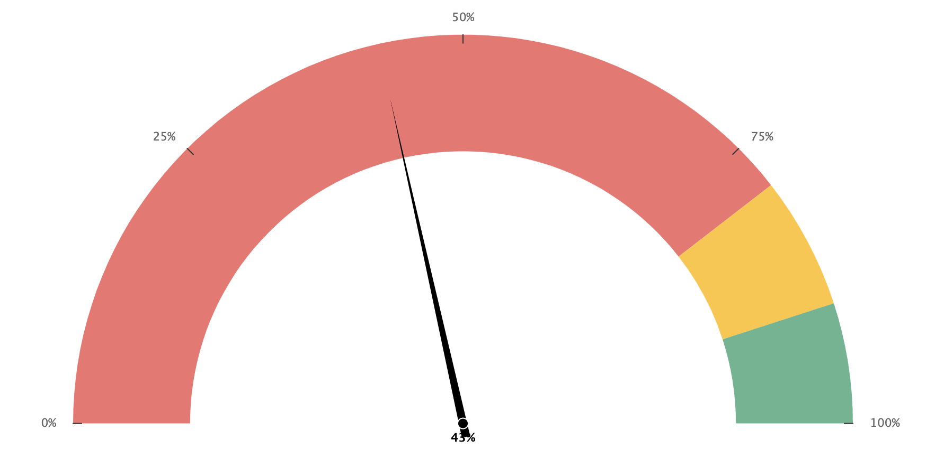
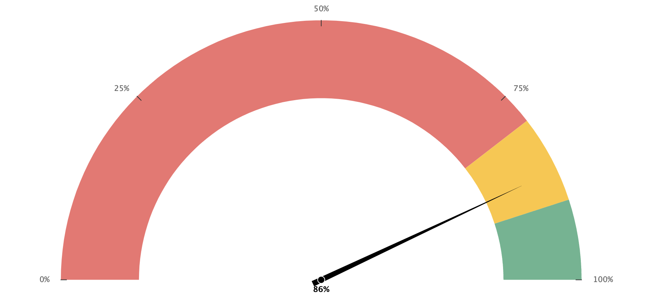
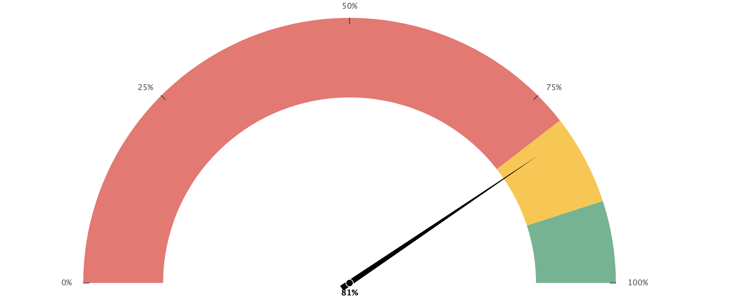
Mock Data Quality Dashboard:
Percentage of Orders with
a Shipping Address
Percentage of credit card records
that have exactly 16 digits.
93%
43%
Percentage of items with
an item status
Percentage of orders with a valid
shipping address and
zip code combination.
86%
*81%
*estimated for mock purposes
Built with Fusion Chats.

Slide 12
Step 5
Master Data Management
Part 1: MDM Architecture

Slide 13
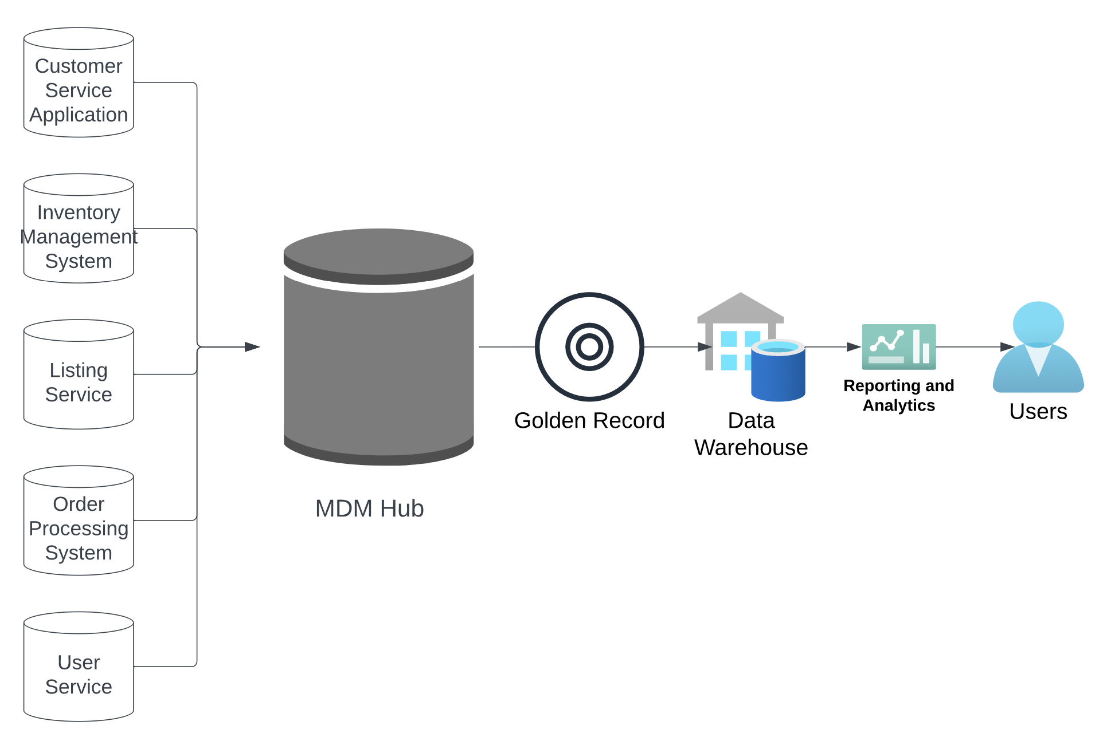
Based on our analysis of SneakerPark’s systems and business model, we recommend the following Consolidated MDM implementation architecture:
Stores the
Golden Record

Slide 14
Explanation:
To help SneakerPark meet its goal of identifing the discrepancies between its various systems that have resulted in mischarges, lost revenues and frustrated customers, we need to build and store the most accurate customer and item records in a consolidated hub. For this reason, we quickly ruled out a Registry MDM Architecture, which essentially stores keys and the various locations of data, but not much else.
At the same time, because SneakerPark must dedicate many of its resources to accommodate its rapid growth, it cannot afford the complexity and cost of implementing an architecture such as a Centralized or Coexistence model, which would require a lot of intrusion into the existing systems. For this reason, we chose a Consolidated MDM implementation architecture.
In our consolidated architecture, data will flow from the various systems into the MDM, which will create the Golden Record, the most accurate version of the data obtained from the various sources. The Golden Record can flow into other downstream systems, such as the Data Warehouse that will be built in phase two, so that it can be used to create more accurate reports and analytics.
If SneakerPark wants to move to a more complex MDM architecture in the future, which would allow for Golden Record data to flow back into the source systems, or for there to be a single point of entry for customer and item data, then the consolidated model can serve as an excellent basis to move forward.

Slide 15
Step 6
Master Data Management
Part 2: Master Record

Slide 16
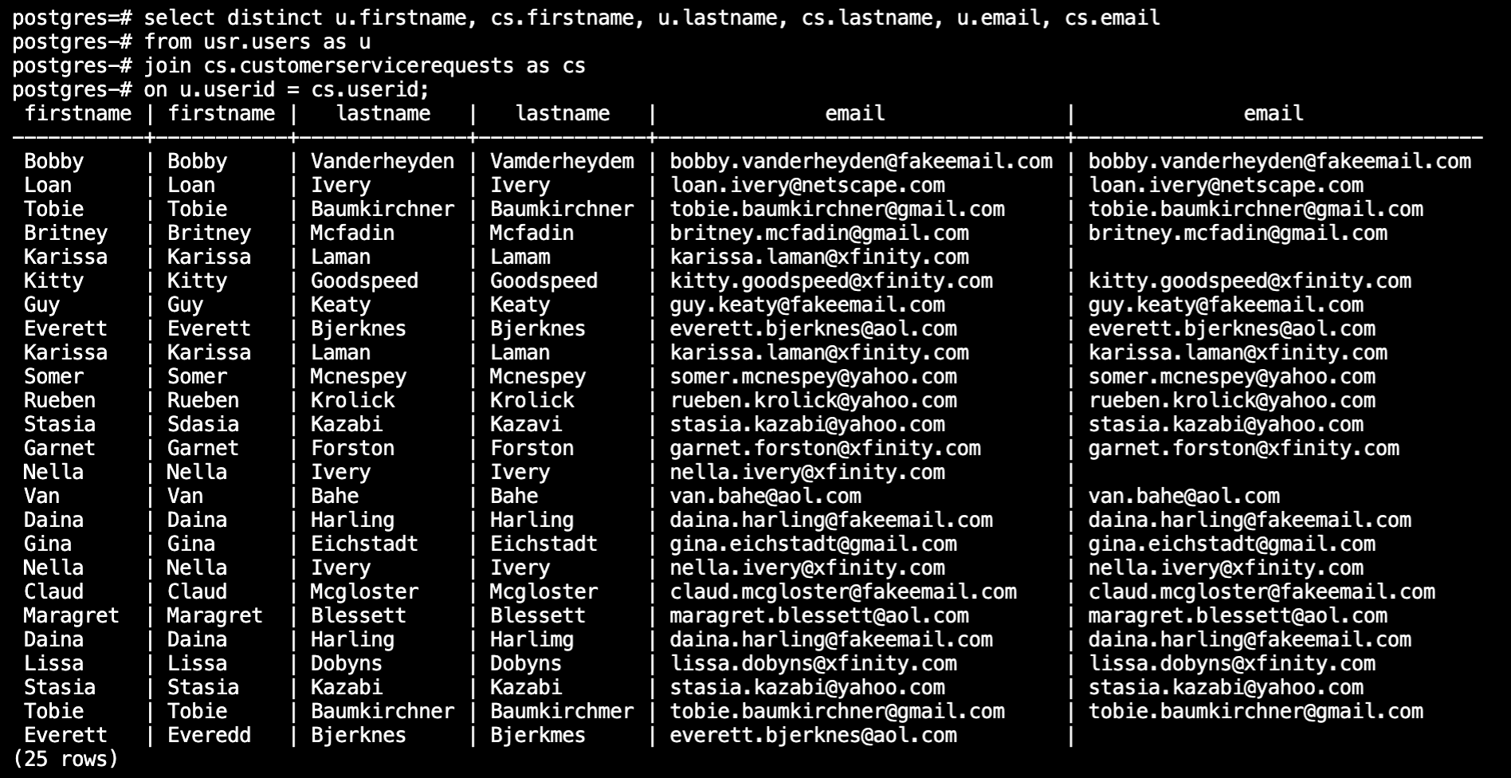
Customer Matching Rules:
Primary Rule: Match customer data on userid.
If we match the respective userid fields from the customerservicerequests and users tables, 25 out of 29 records on the customerservicerequests table are matched. (See the screenshot below.)
This rule can be applied to other tables as well. For example, to match the records between the orders table and the users table we would match the orders’ buyerid field with the users’ userid field.

Slide 17
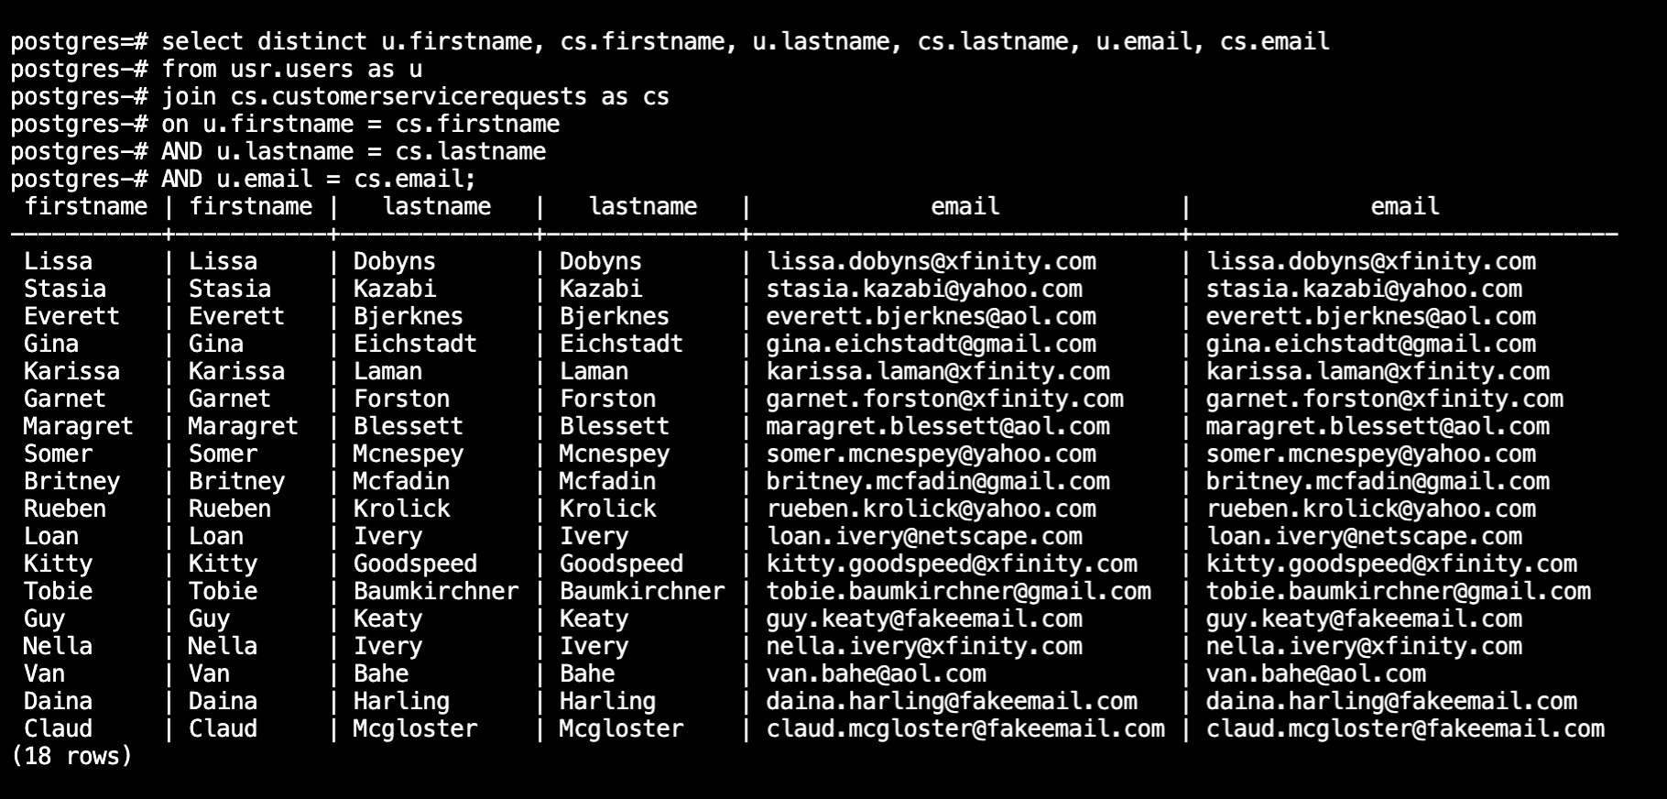
Customer Matching Rules, cont.:
Secondary Rule: Match on first name, last name and email.
If we continue with our example of finding matches between the users and the customerservicerequests table, then we notice that the two tables also have the firstname, lastname and email columns in common. Fuzzy matching could be added for each field to increase the number of matches. See an example query that simulates this rule below:

Slide 18
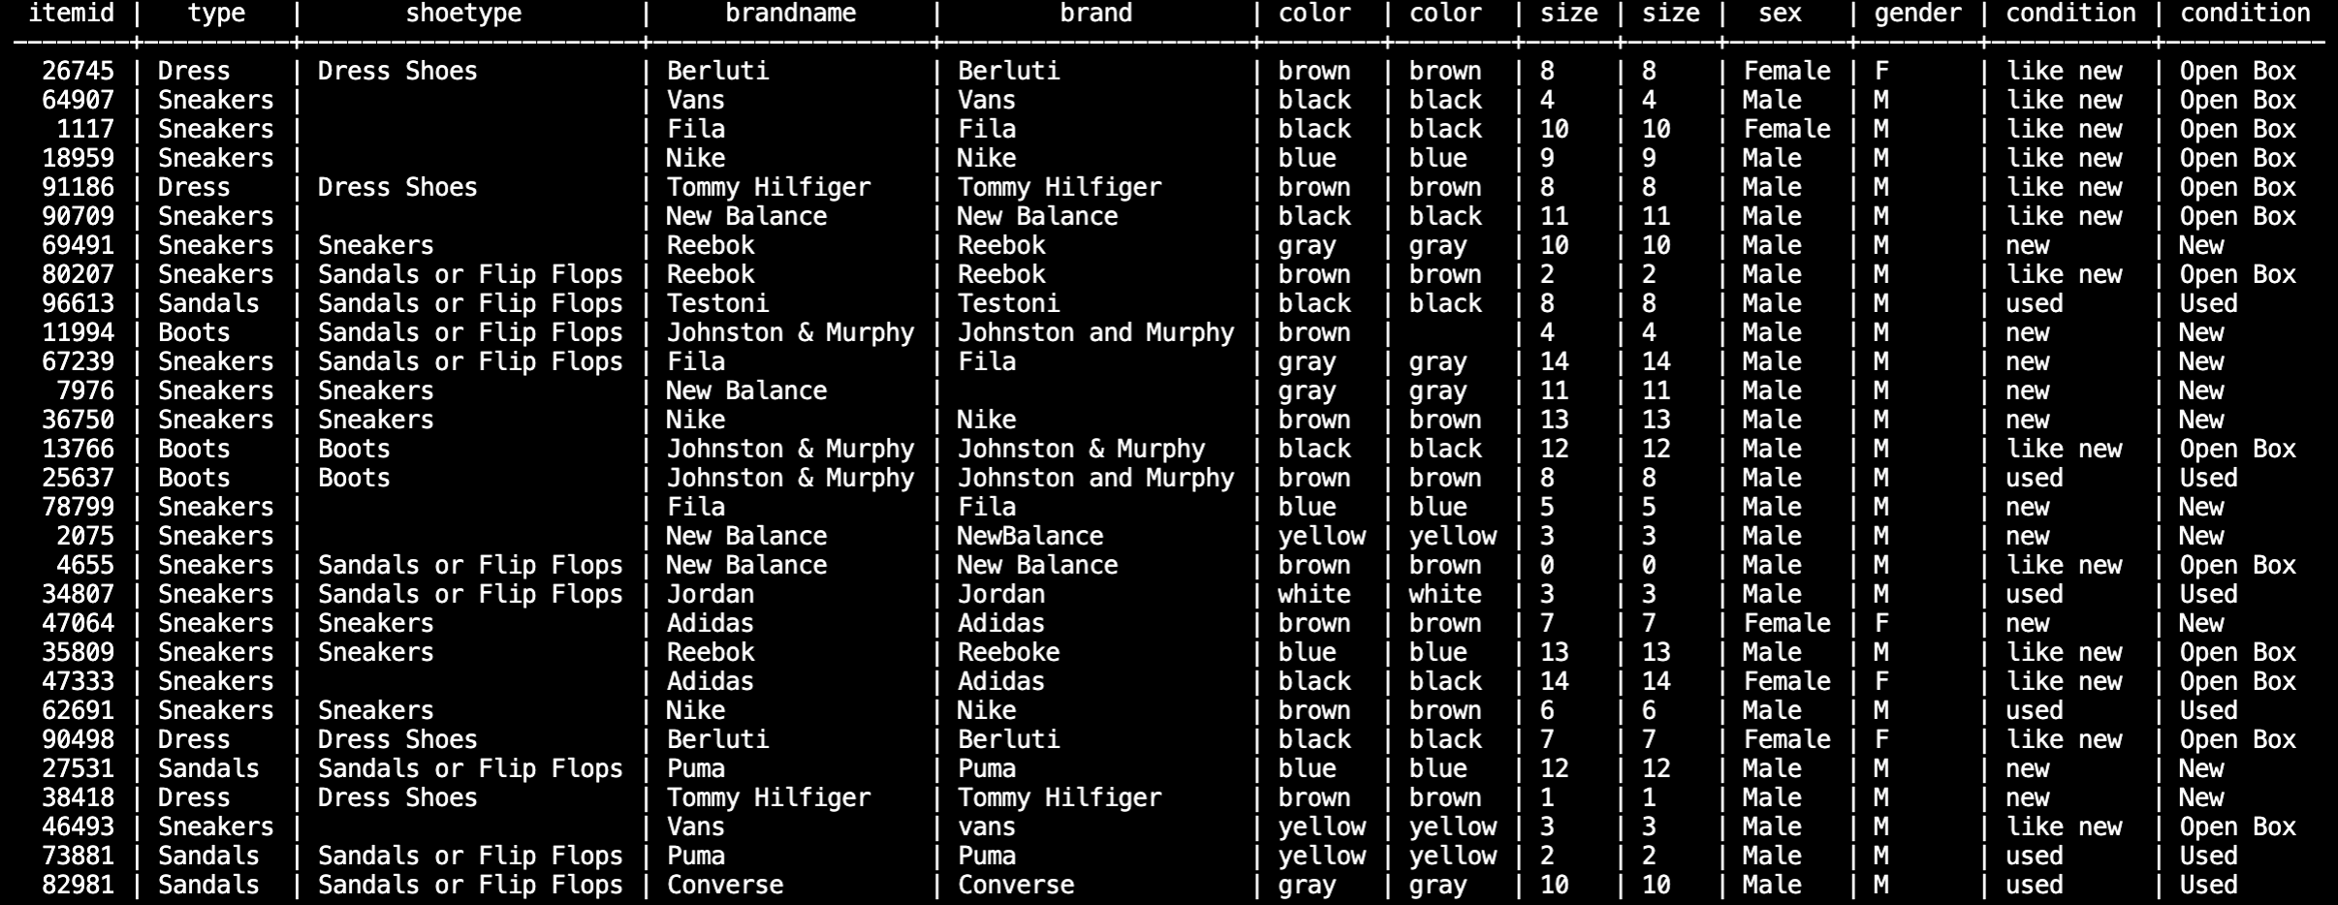
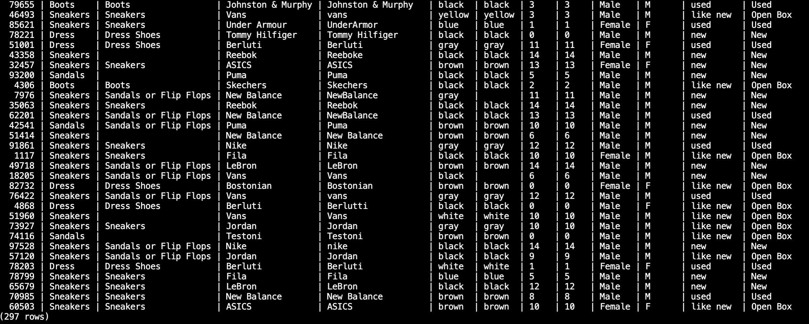
Item Matching Rules:
Primary Rule: Match item data on itemid.
To match records between the items and the listings table, we can use the following query:
select distinct it.itemid, it.type, li.shoetype, it.brandname, li.brand, it.color, li.color, it.size, li.size, it.sex, li.gender, it.condition, li.condition from im.items as it
join li.listings as li on it.itemid = li.productid;
It produces 297 matches. (See partial results below.)

Slide 19
Item Matching Rules, cont.:
Secondary Rule: Match item data on type (fuzzy), brand name (fuzzy), color, size, sex/gender (fuzzy) and condition (fuzzy).
The fields named above are common to both the items and listings tables. As we can see from the partial query results below, there is a lot of missing data in the listing table in the shoetype column so it should be fuzzy and not given a lot of weight. However, brand, color, size, sex/gender, and condition are reasonably close matches between the two tables. There are slight differences between brand spellings, the capitalization of conditions, and how genders are captured between the two systems, so these matches should be fuzzy.
It would be better if we had a shoe model name, such as Nike Air. This is something we should consider capturing in the future.

Slide 20
Step 7
Data Governance:
Roles and Responsibilities

Slide 21
One of the most critical roles for setting up data governance is that of the data steward. Their key responsibilities include data quality management : defining match rules, reviewing and/or overriding match results, approving or rejecting golden records, reviewing rejected records, and manually creating golden records when required. Given her experience as a subject matter expect and her experience diagnosing data issues and finding solutions for them in the past, Jessica would be a good candidate for this role. However, given her current workload, we should add at least one additional employee with whom she can share these responsibilities.
Another critical role that SneakerPark will need for implementing data governance is that of the Data Owner. This person is responsible for the classification, protection and overall quality of an organization’s data, including metadata management, data dictionaries and master data management. Because they typically oversee the work of data stewards, they are generally a more senior person within the company. Given his experience administering SneakerPark’s database systems, Jake has the critical knowledge necessary to create metadata and maintain a data dictionary. However, given his lack of management experience and because he plays a critical role in the ongoing support of the existing systems, we should add a resource to the team who specifically has management experience and knowledge of the data domains. We can commence our search by determining whether an internal resource could add this role to their current responsibilities.

